Slide 1

Customer Prediction, Profiling & Classification of ODDO-BHF Securities Clients
Elaborate by :
Mohamed Iheb Bousnina
Fedi Bayoudh
Mhadheb Ben Mahmoud
Montassar Thabti
Khalil Ben Romdhane
http://www.free-powerpoint-templates-design.com

Slide 2
Plan
01
Business Objectives
02
Data understanding
03
Data integration
04
Modeling
05
Data Visualization
2

Slide 3



Introduction
3
Notes:
Oddo bhf main goal is to be connected to their customers and able to provide them with the best financial decisions and that by managing its data and incorporate it into its business and professional practices. Our main mission in this project is to help Oddo make those decisions by presenting prediction values for its customers by analyzing and interpreting the provided data in order to help it reach better decisions.

Slide 4
Introduction
This solution will enable Oddo-BHF Securities management to better understand the client and his behaviors and optimize customer service and satisfaction.
…
This project will be an opportunity for our group to demonstrate the value and relevance of technologies innovation.
On this occasion, we will be able to rely on the data provided by analyzing the history of the portfolio, heritage customer, performance data …
…
4

Slide 5
Business Objectives
5
Notes:
Oddo bhf main goal is to be connected to their customers and able to provide them with the best financial decisions and that by managing its data and incorporate it into its business and professional practices. Our main mission in this project is to help Oddo make those decisions by presenting prediction values for its customers by analyzing and interpreting the provided data in order to help it reach better decisions.

Slide 6

Business Objectives
Determining commercial customer segments, Determining customer profiles by similarity
Determination of an individualized risk aversion score, Determination of client selection criteria
Individualized collection amount ,Evolution of customer‘s account: Account opening, Variation, PAMP, total titles, PMA…
Prediction of business opportunity due + X months
6

Slide 7
Data understanding
7
Notes:
Oddo bhf main goal is to be connected to their customers and able to provide them with the best financial decisions and that by managing its data and incorporate it into its business and professional practices. Our main mission in this project is to help Oddo make those decisions by presenting prediction values for its customers by analyzing and interpreting the provided data in order to help it reach better decisions.

Slide 8
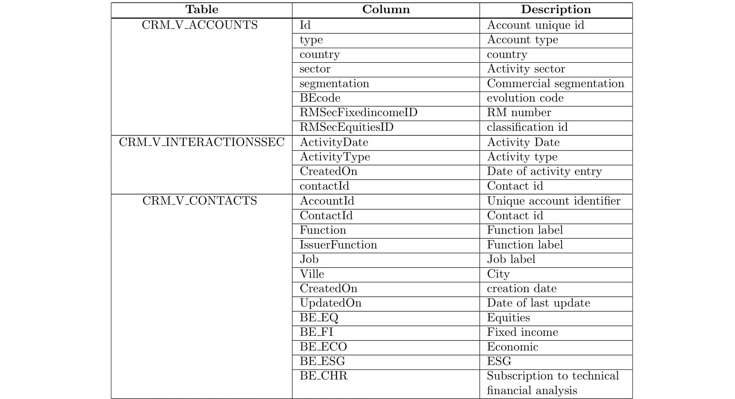
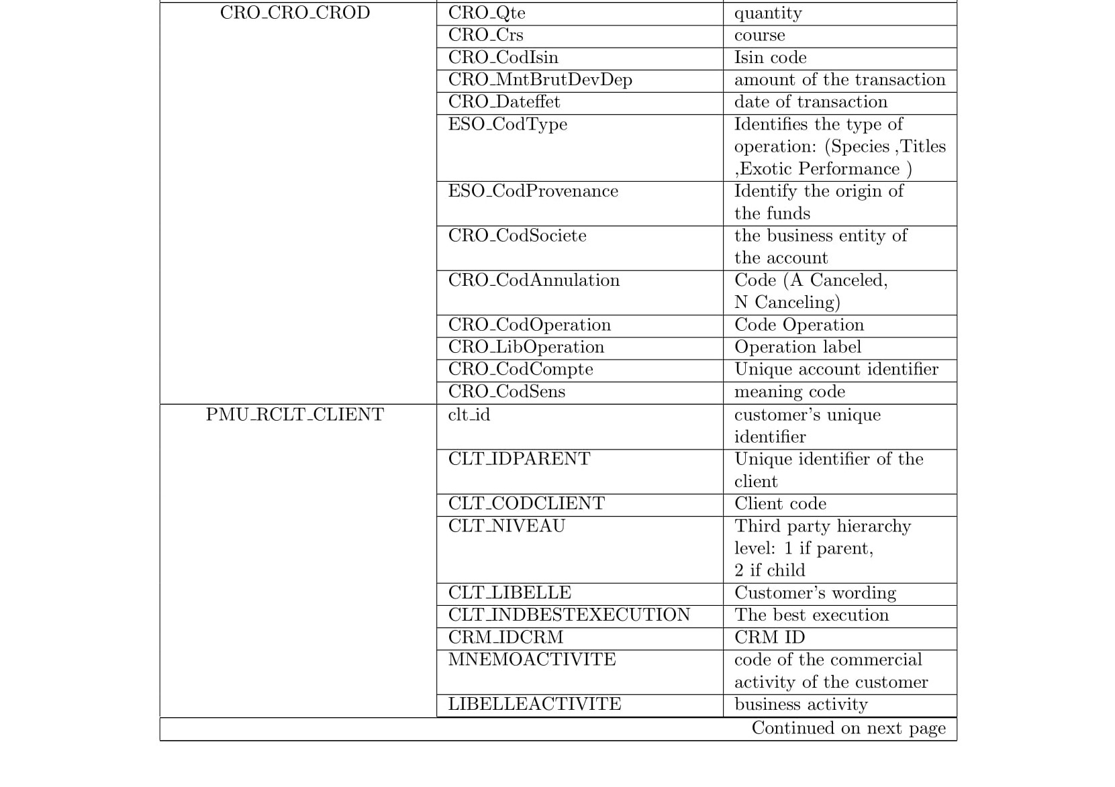
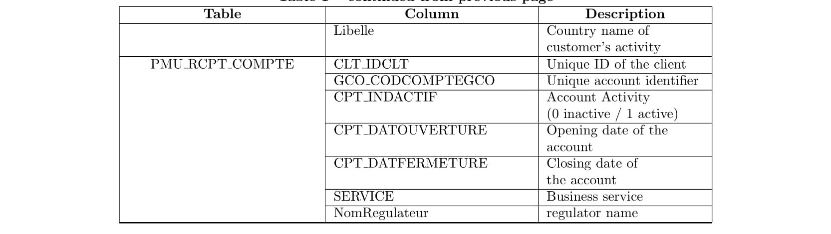
Data understanding [1/3]
8

Slide 9
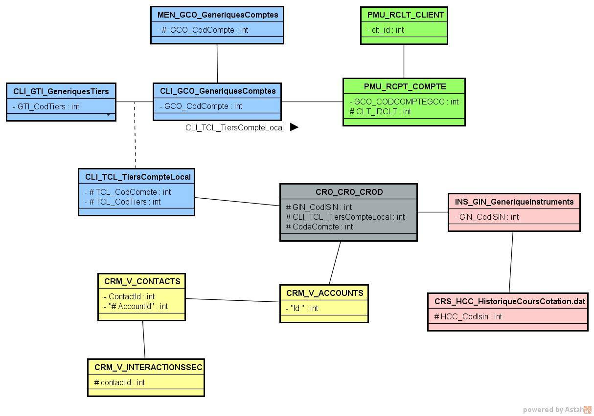
Data understanding [2/3]
9

Slide 10
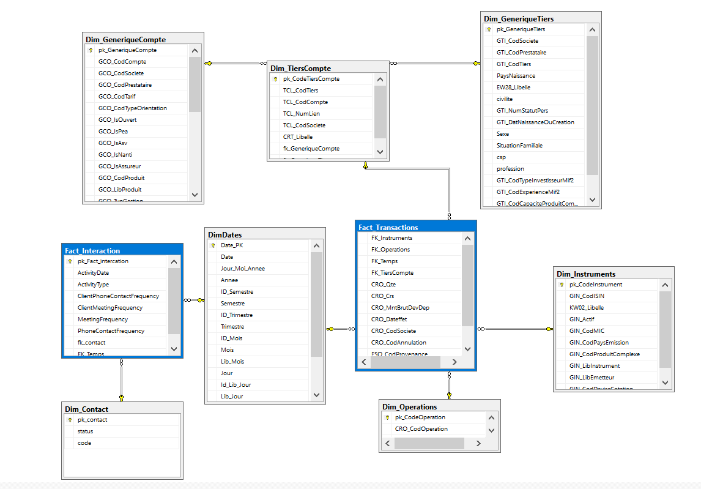
Data understanding [3/3]
10
DW Schema

Slide 11
Data integration
11
Notes:
Oddo bhf main goal is to be connected to their customers and able to provide them with the best financial decisions and that by managing its data and incorporate it into its business and professional practices. Our main mission in this project is to help Oddo make those decisions by presenting prediction values for its customers by analyzing and interpreting the provided data in order to help it reach better decisions.

Slide 12
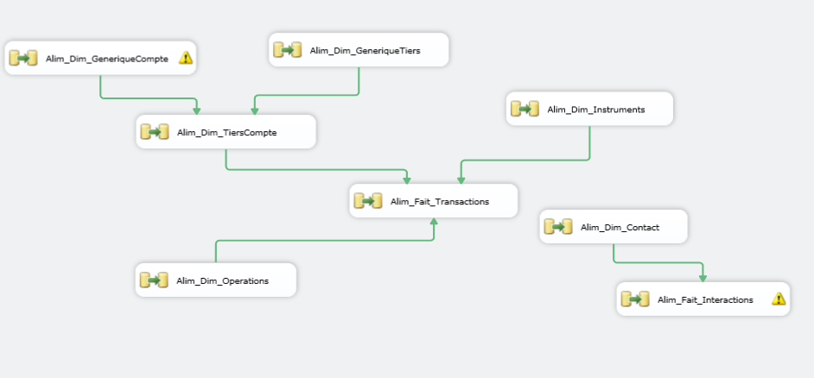
Data integration [1/6]
12

Slide 13
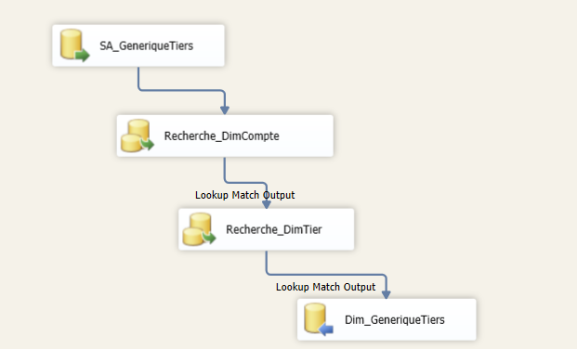
Data integration [2/6]
~ Lookup component ~
13

Slide 14
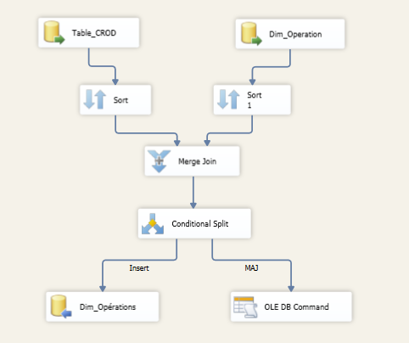
Data integration [3/6]
~ Merge Join component ~
14

Slide 15
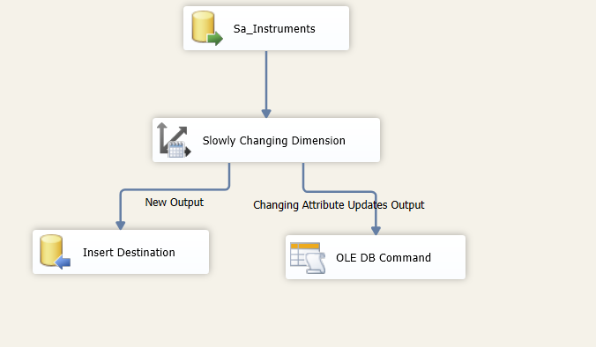
Data integration [4/6]
~ Slowly dimensions component ~
15

Slide 16
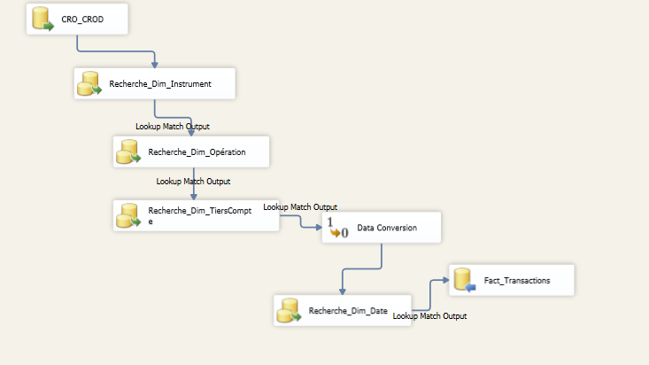
Data integration [5/6]
~ Fact “Transactions” integration ~
16

Slide 17
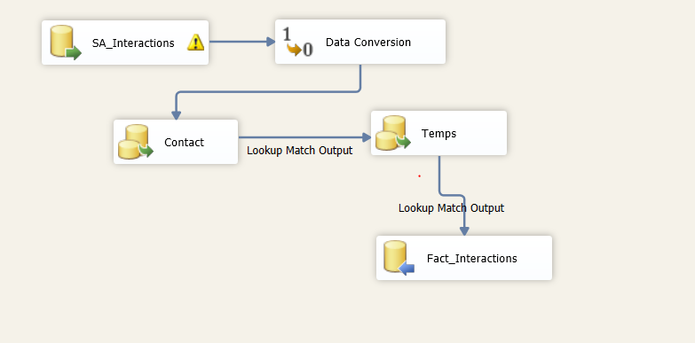
Data integration [6/6]
~ Fact “Interactions” integration ~
17

Slide 18
Modeling
18
Notes:
Oddo bhf main goal is to be connected to their customers and able to provide them with the best financial decisions and that by managing its data and incorporate it into its business and professional practices. Our main mission in this project is to help Oddo make those decisions by presenting prediction values for its customers by analyzing and interpreting the provided data in order to help it reach better decisions.

Slide 19
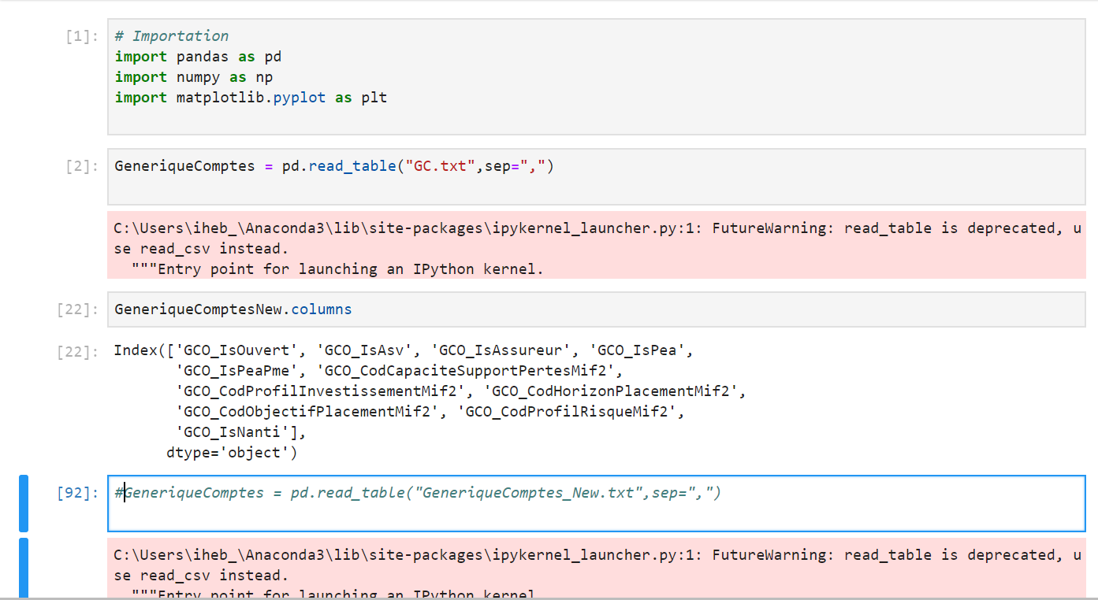

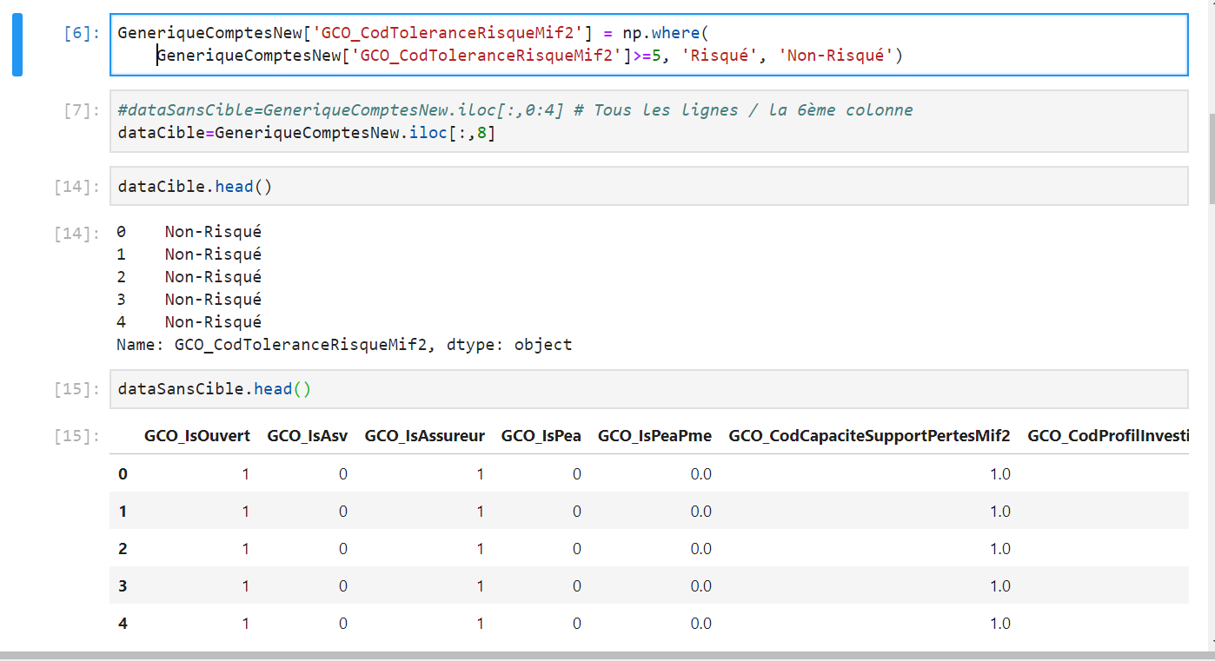
Modeling [1/6]
~ Prepare the data ~

Slide 20
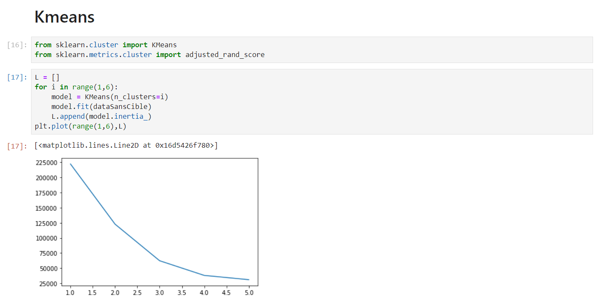
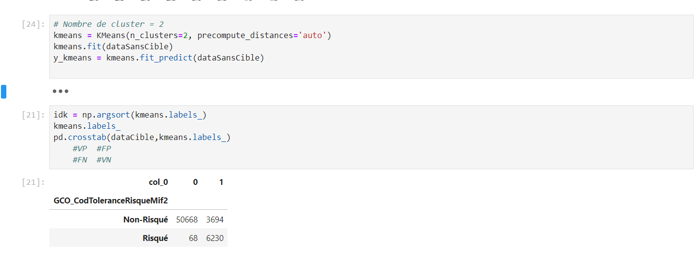
Modeling [2/6]
~ Kmeans (Profiling) ~

Slide 21
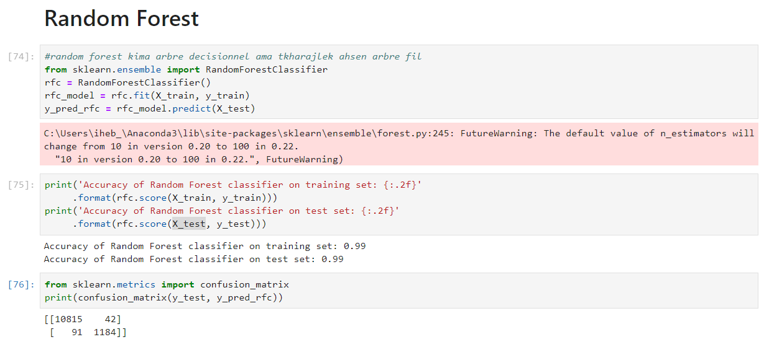
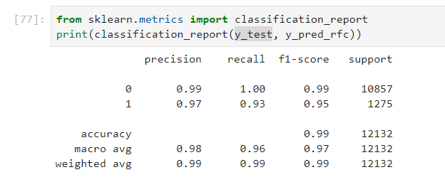
Modeling [3/6]
~ Random Forest ~

Slide 22
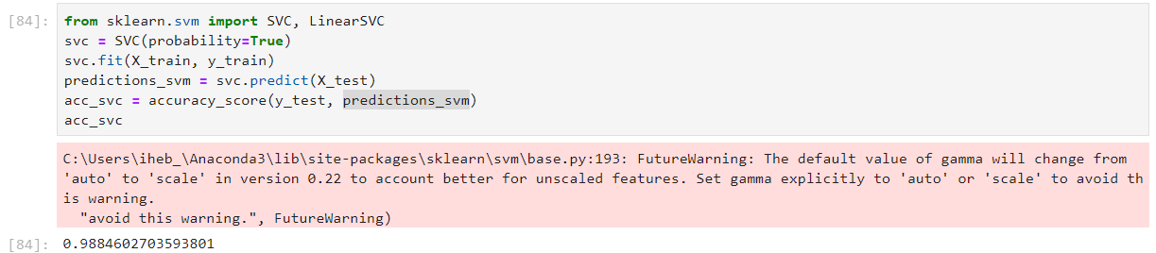
Modeling [4/6]
~ Support Vector Machine ~

Slide 23
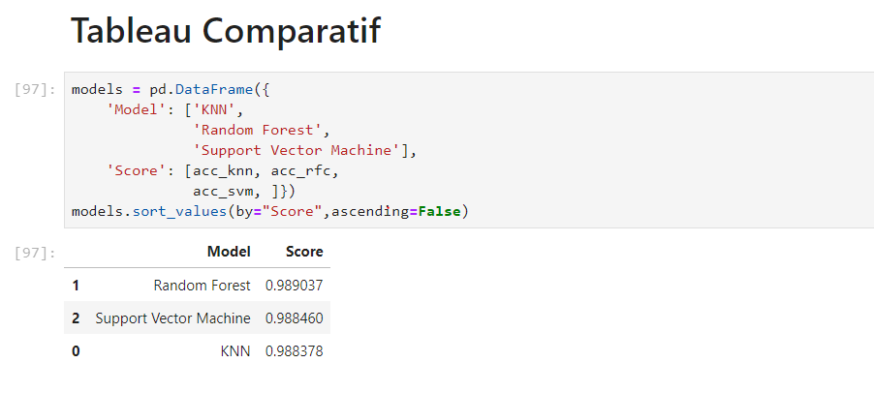
Modeling [5/6]
~ Classification of Models (f1-score) ~

Slide 24
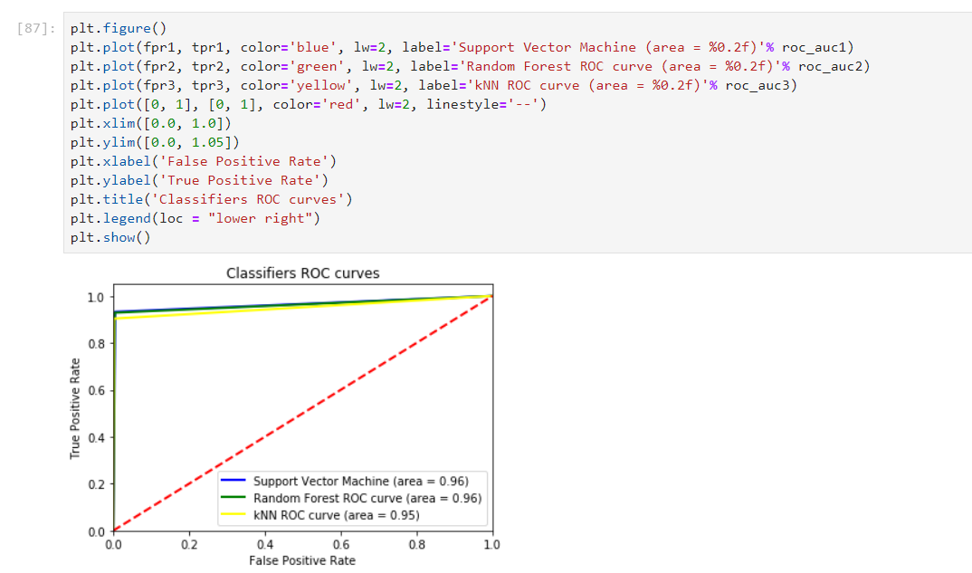
Modeling [6/6]
~ ROC Curve~

Slide 25
Data Visualization
Notes:
Oddo bhf main goal is to be connected to their customers and able to provide them with the best financial decisions and that by managing its data and incorporate it into its business and professional practices. Our main mission in this project is to help Oddo make those decisions by presenting prediction values for its customers by analyzing and interpreting the provided data in order to help it reach better decisions.

Slide 26
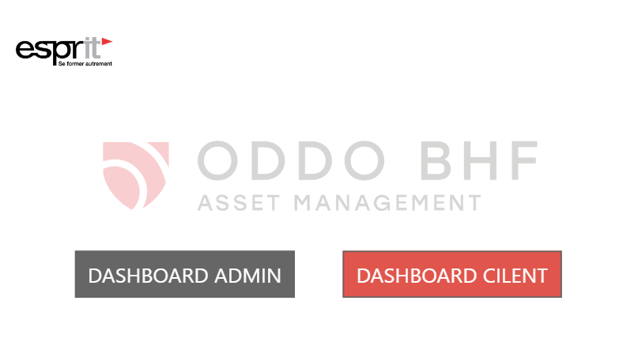
Data visualization [1/7]

Slide 27
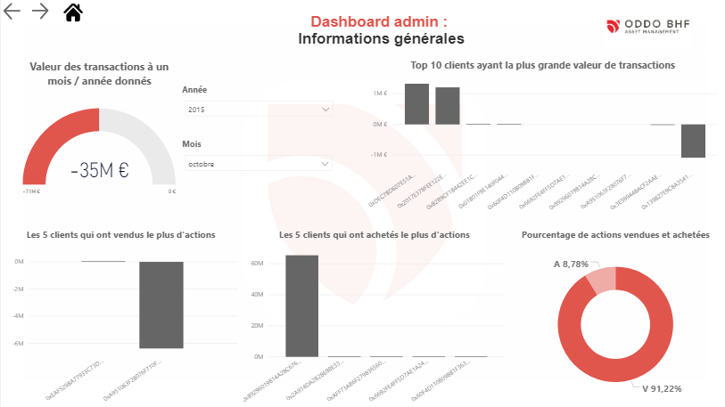
Data visualization [2/7]

Slide 28
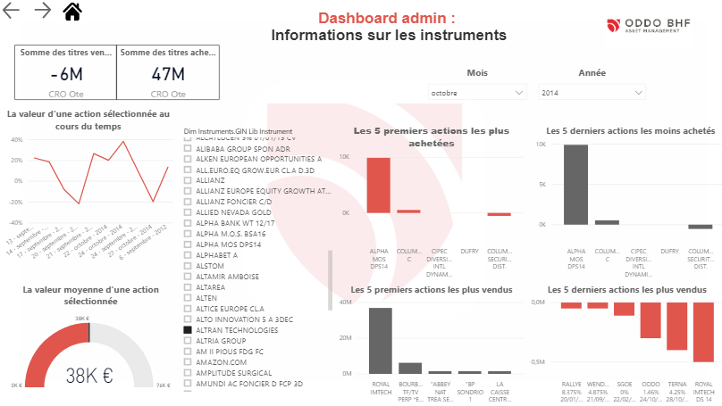
Data visualization [3/7]

Slide 29
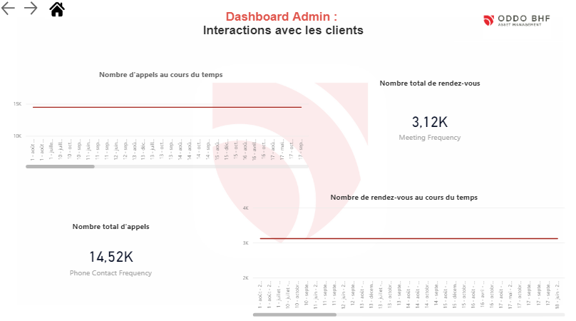
Data visualization [4/7]

Slide 30
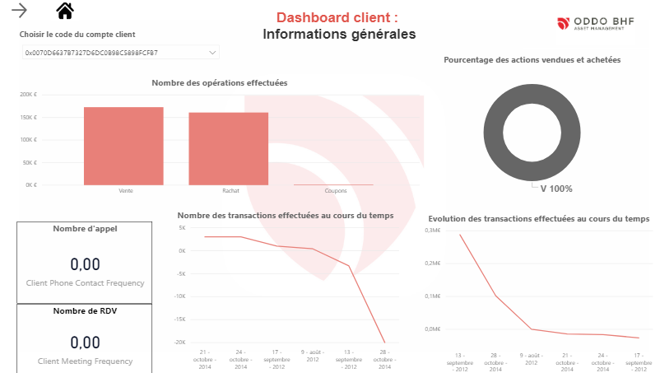
Data visualization [5/7]

Slide 31
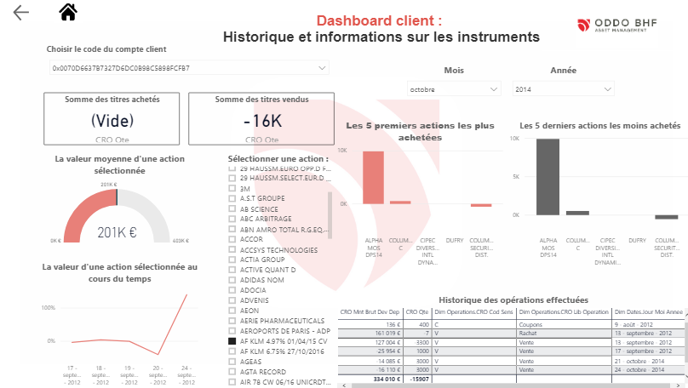
Data visualization [6/7]

Slide 32
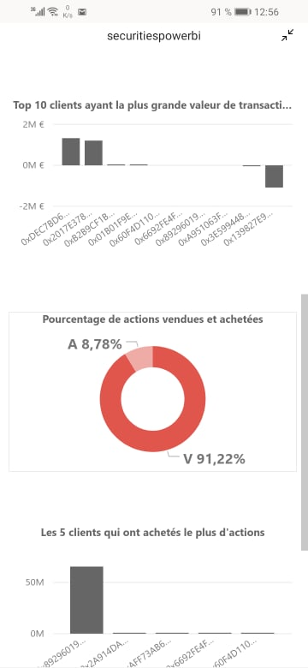
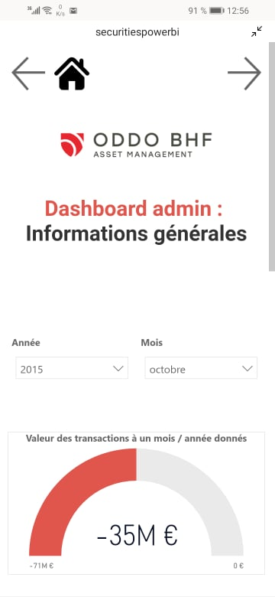
Data visualization [7/7]

Slide 33
Conclusion
Notes:
Oddo bhf main goal is to be connected to their customers and able to provide them with the best financial decisions and that by managing its data and incorporate it into its business and professional practices. Our main mission in this project is to help Oddo make those decisions by presenting prediction values for its customers by analyzing and interpreting the provided data in order to help it reach better decisions.

Slide 34






Tools
Tools & Technologies

Slide 35
Thank you for your attention
Questions
Criticals
Suggestions

